Slide 1

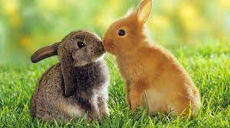
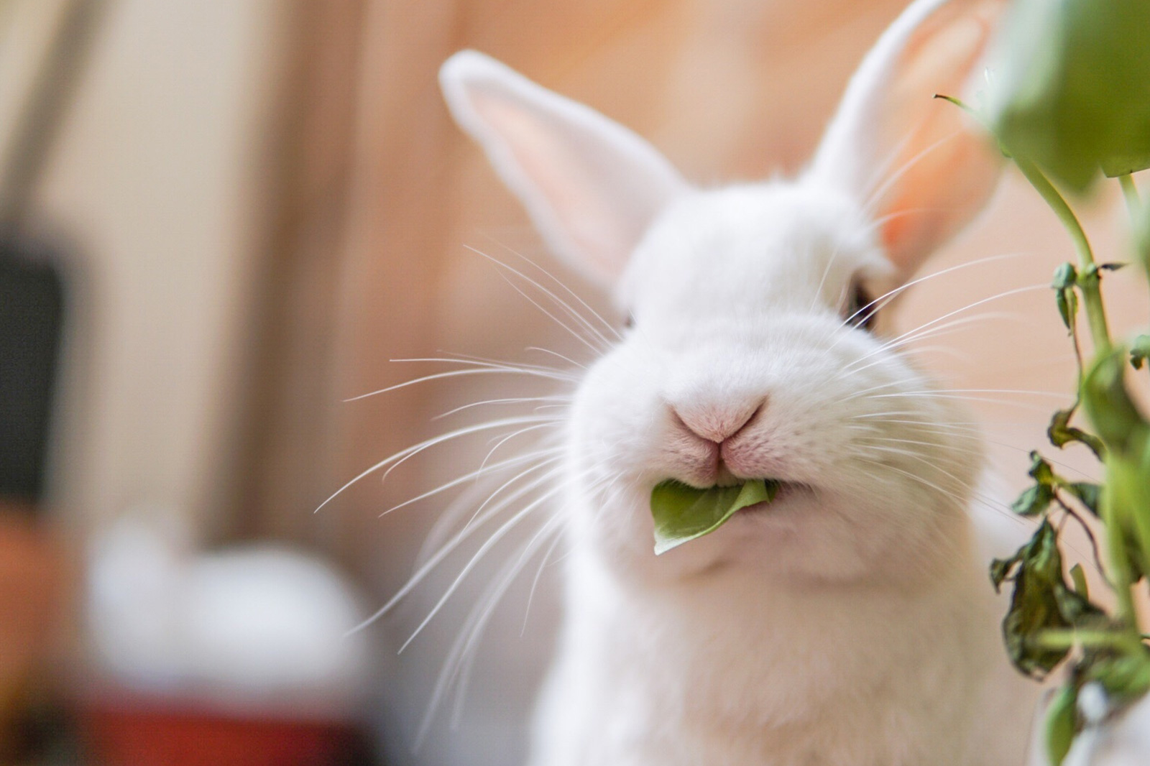
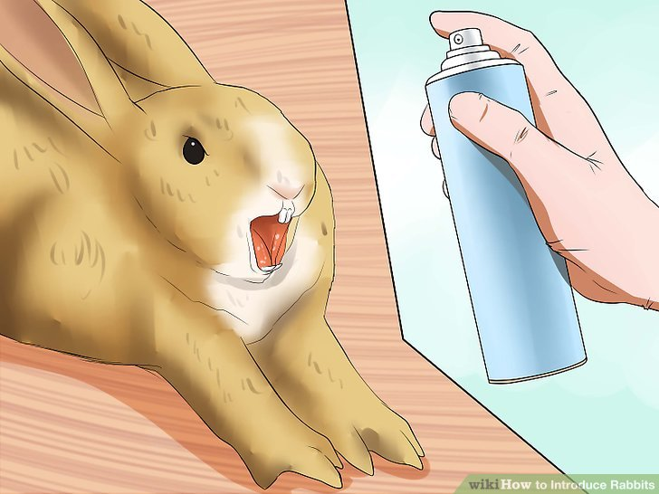
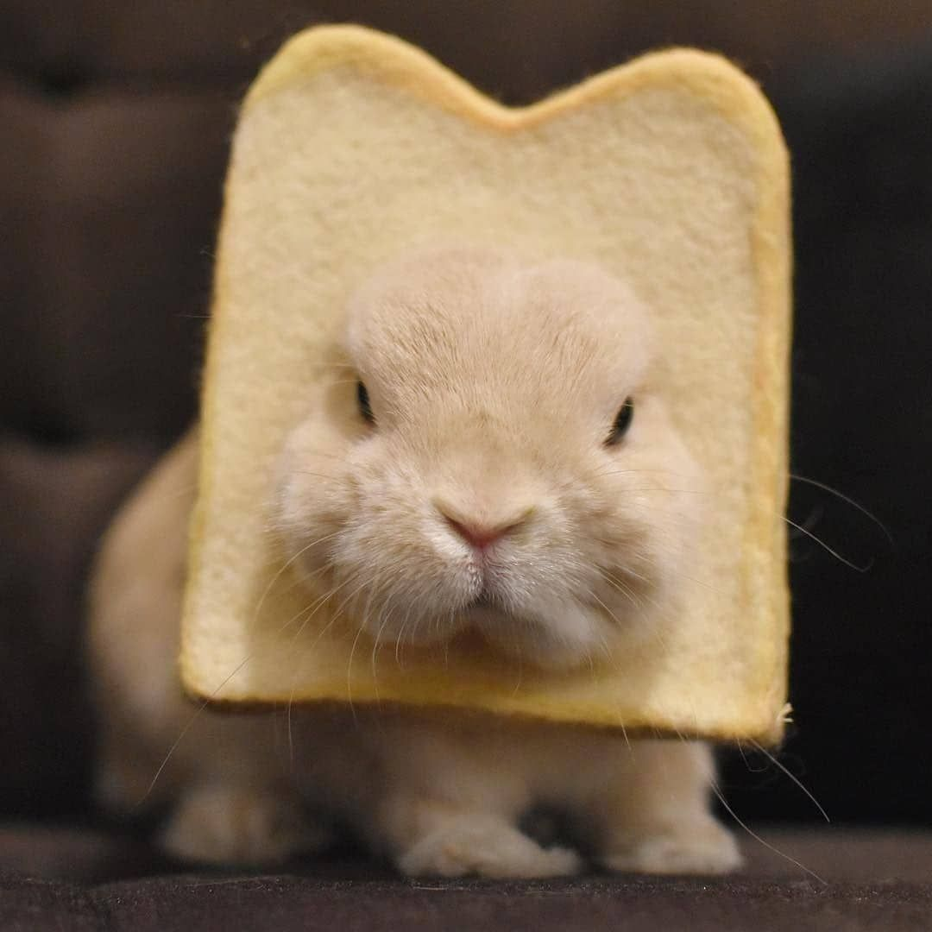
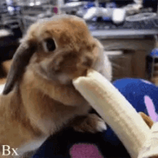
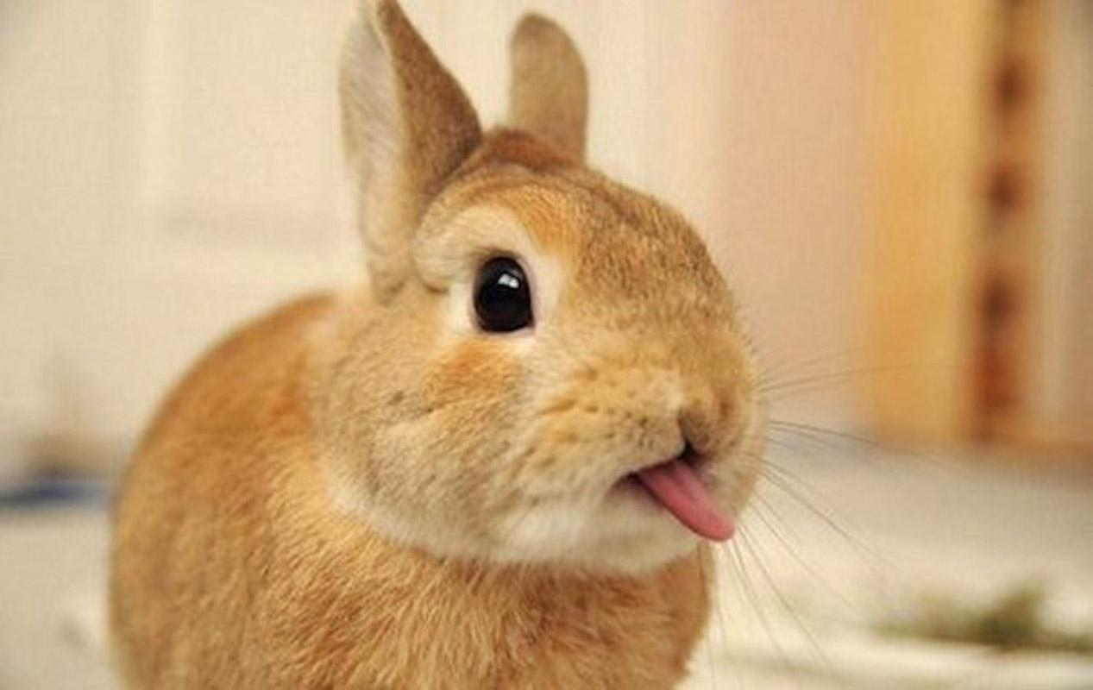
BUNNIES
DISCLAIMER: I’ve not looked up most bunny facts this is just what I know from the top of my head and my sister is the
Real bunny expert so Amber if you see any mistakes, please don’t kill me
How to accurately play rabbit folk

Slide 2
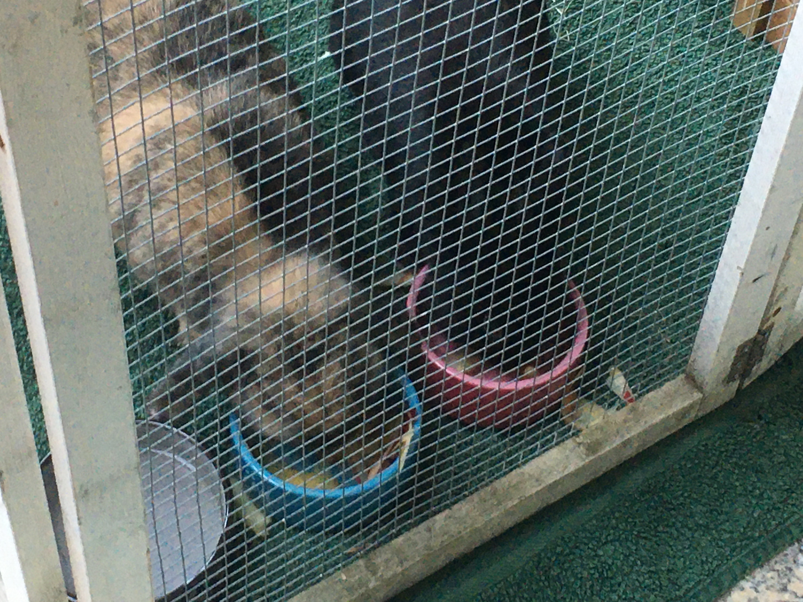
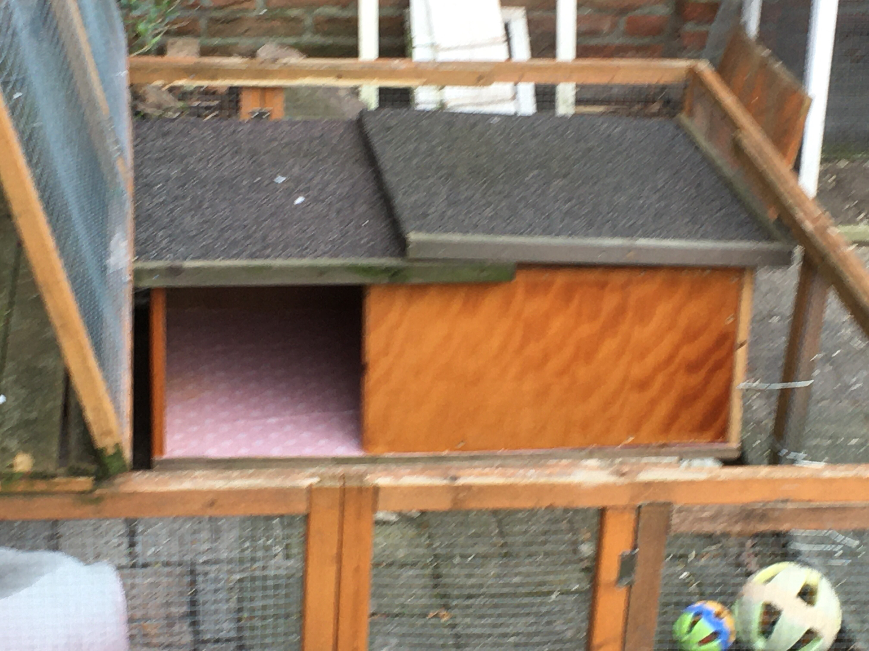
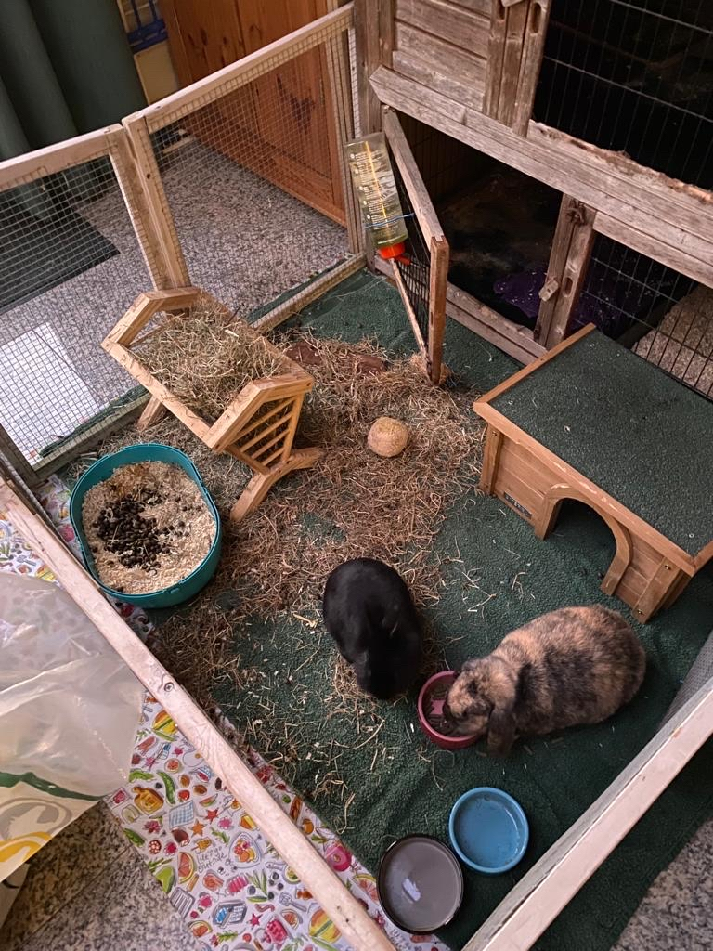
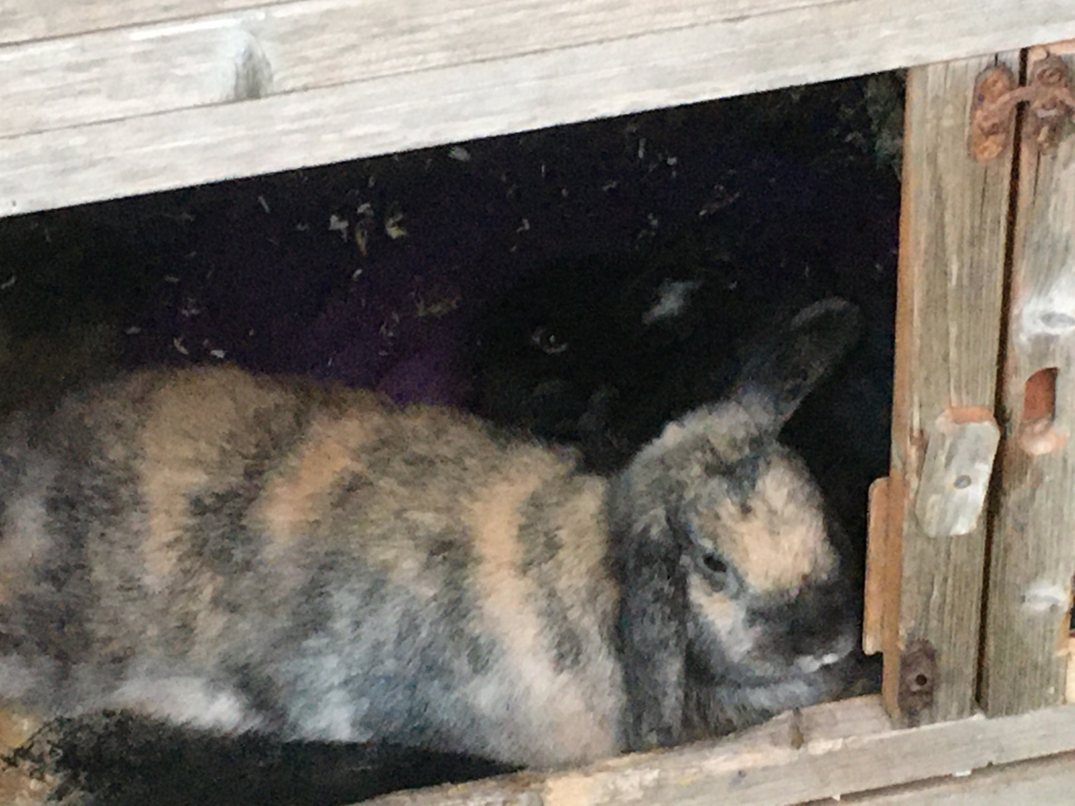
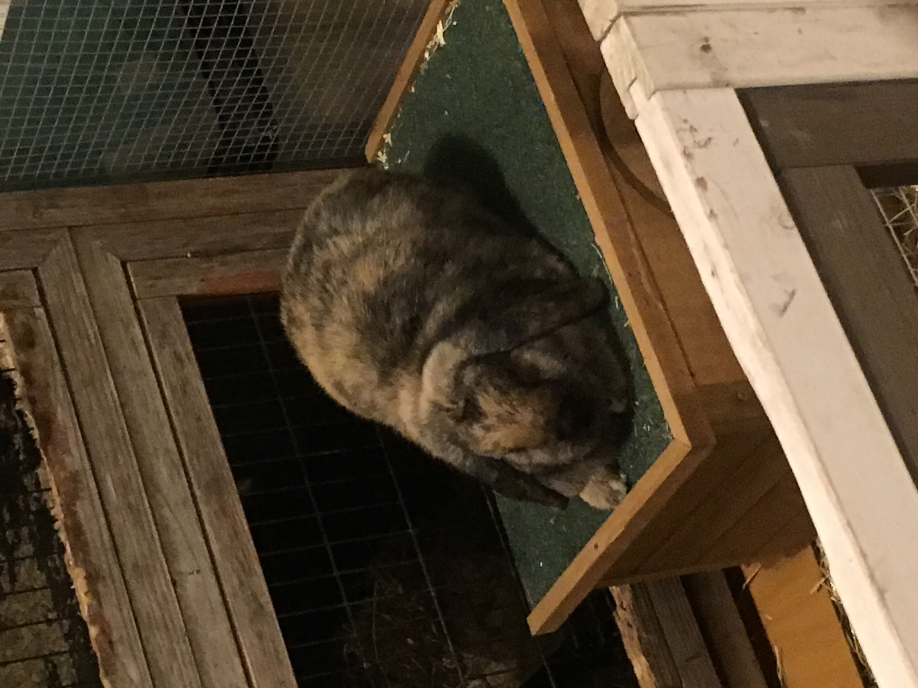
Bunny facts about me
Had bunnies since a kid
My sister and me bunny sit for a bunny shelter (Konijn & Ko)
My sister is absolutely obsessed with bunnies
We’re baby sitting 5 now (it’s more busy cuz of vacation)
Currenly have 2 bunnies of our own
(so 7 bunnies in the house)
Elfi found Charlie on the STREETS
Bunny is adopted
Charlie
Bunny

Slide 3
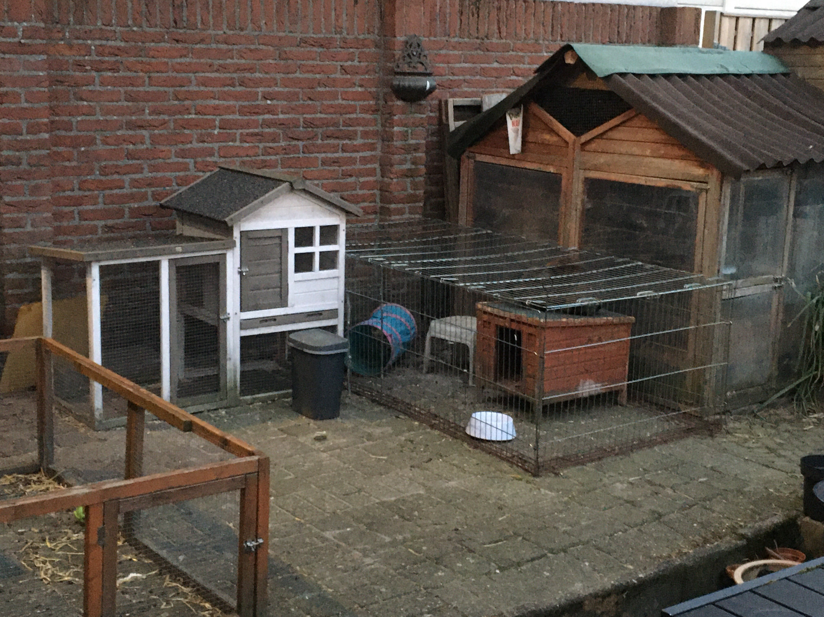
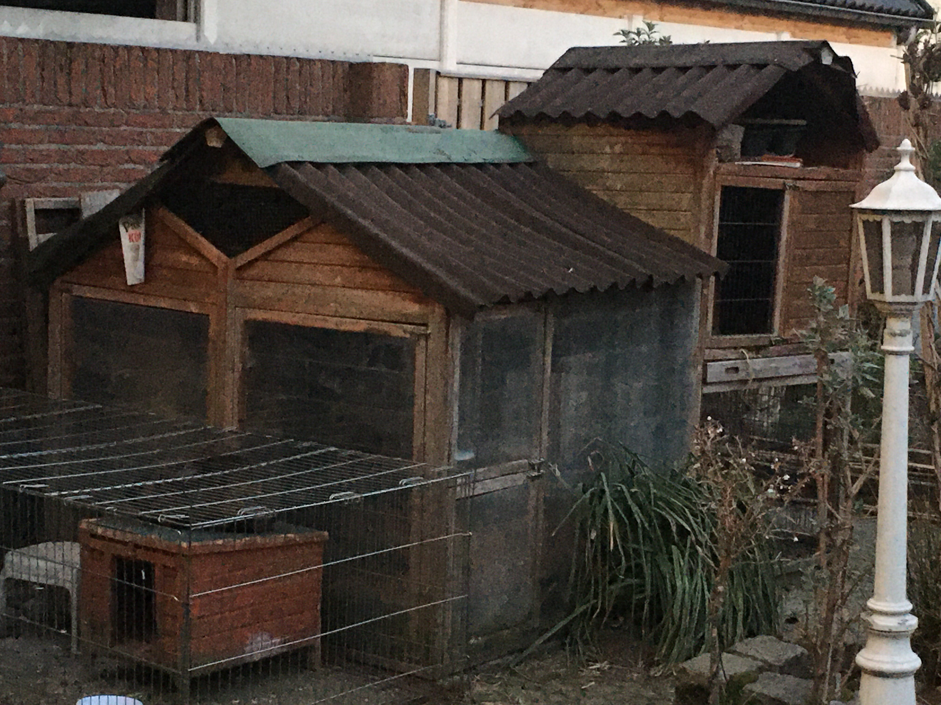
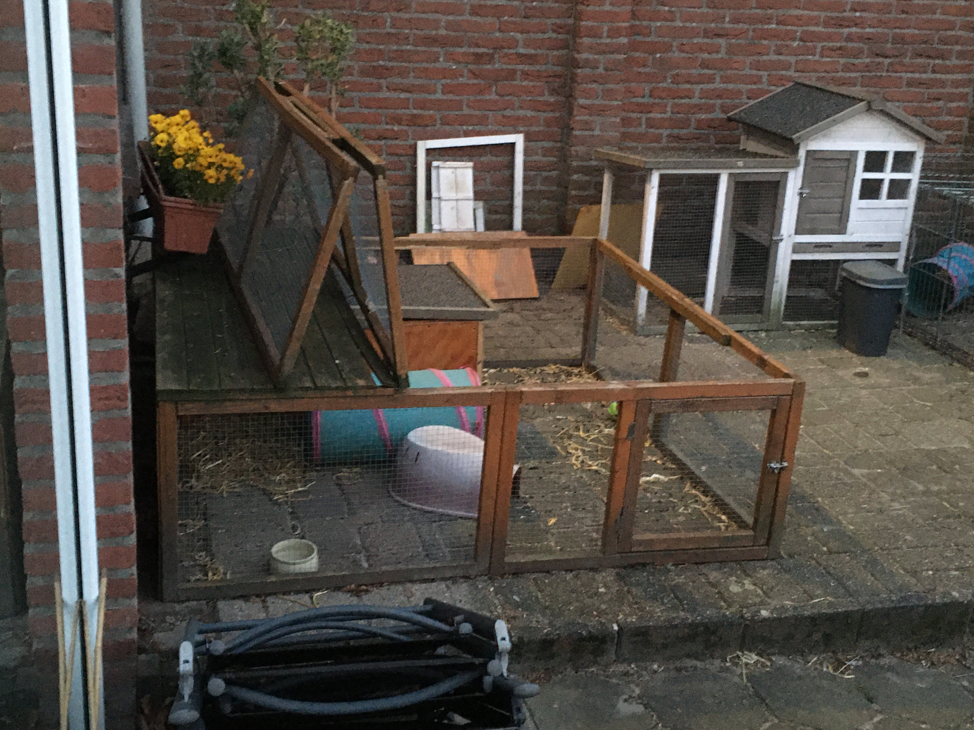
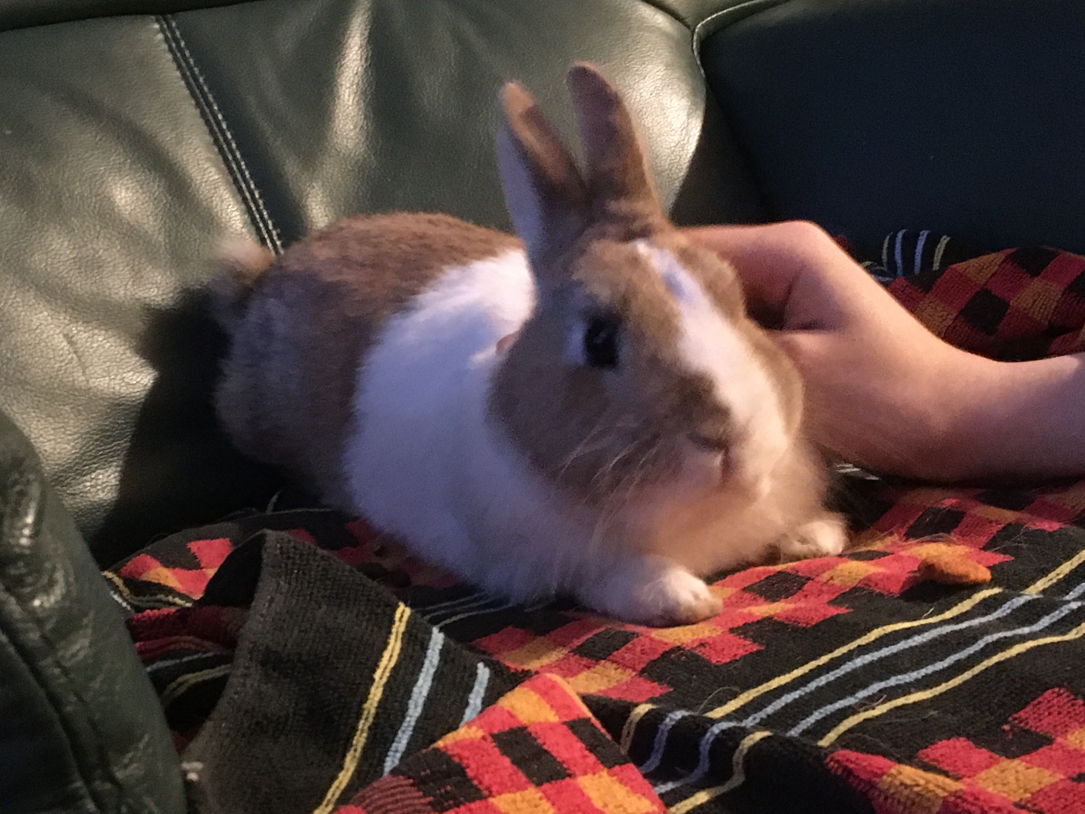
Bunny facts about me
Had bunnies since a kid
My sister and me bunny sit for a bunny shelter (Konijn & Ko)
My sister is absolutely obsessed with bunnies
We’re baby sitting 5 now (it’s more busy cuz of vacation)
Currenly have 2 bunnies of our own
(so 7 bunnies in the house)
Elfi found Charlie on the STREETS
Bunny is adopted
Grovert
Bunny

Slide 4
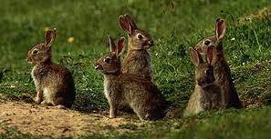
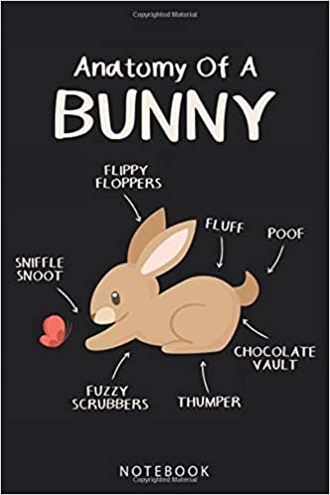
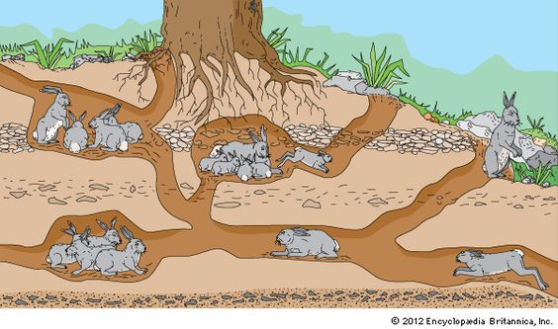
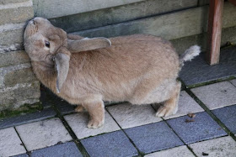
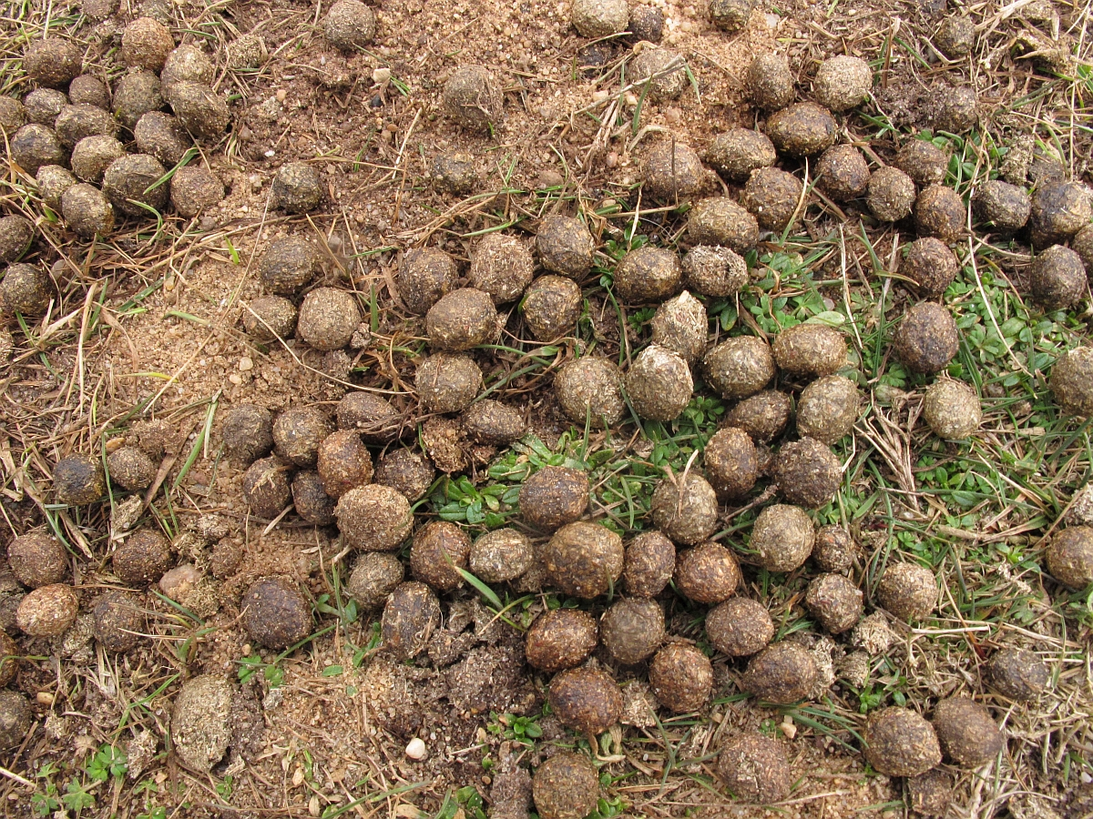
Some basic facts
Bunny’s live in groups
They’re most active in twilight times
They live in little bunny burrows
They make things smell like them, dig the ground a bit and leave poops / pee behind to show territory

Slide 5
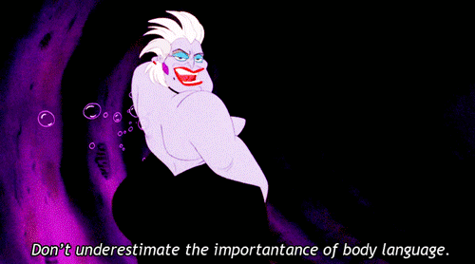
Some bunny language
The moving of the nose: I’m interested in this
A rise of the tail: danger
Thump: danger
Flattening of the ears: anger/threatened
Flicking sand in your direction: fuck you (this has happened to me several times)
Nudge against you: Hi! :)
Gritting teeth lightly: I like this SO FUCKING MUCH I’m so comfy
Gritting teeth but with the
sound of almost grinding stone: I HATE THIS I’m really uncomfy
Weird jump: WHOOO I’m so happyyyyy
Not super fun fact! Bunnies can let out a scream if they’re really scared.

Slide 6
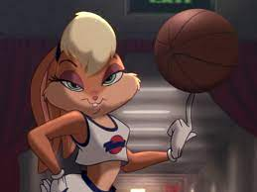
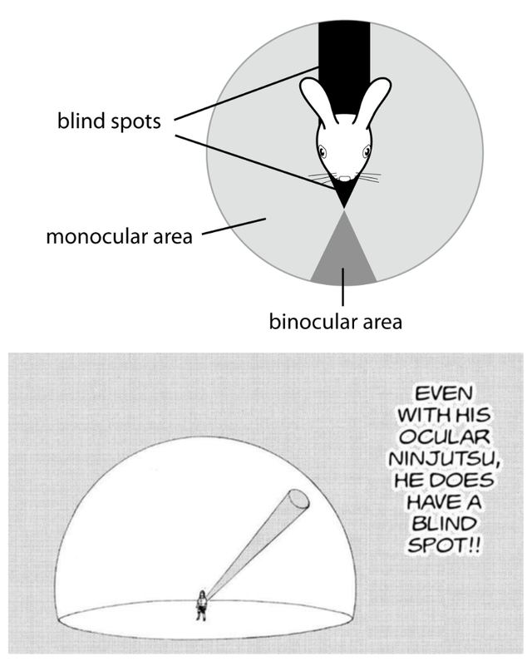
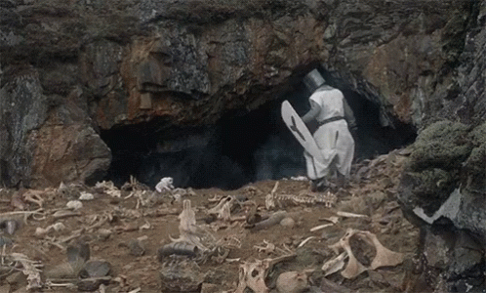
How to adopt approach a bunny
Bunnies can’t see up and down as well because they’re prey animals show your hand in their field of vision
Be slow
Let em sniff
Pro tip: Just take potential bites like a (wo)man they’re literal fluff balls you’ll handle it.

Slide 7
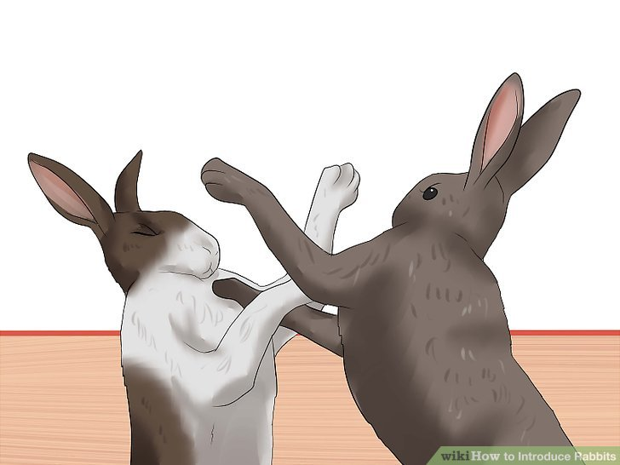
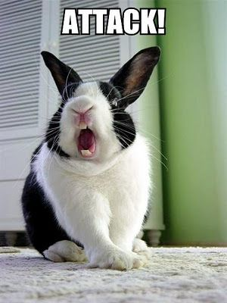
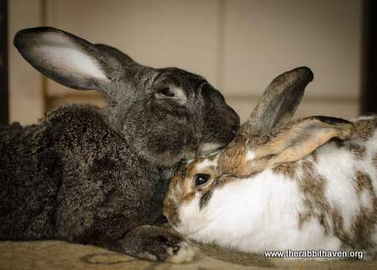
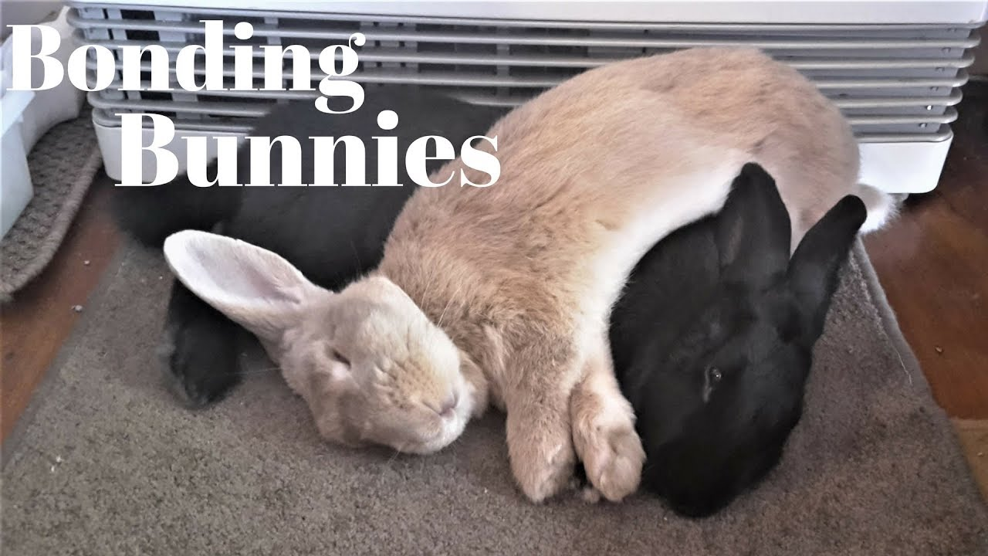
Introducing bunnies to each other
Female bunny is the “alpha” (yes poke I put this in here for you)
Neutral area
Power struggle is visible they’ll fight a little probably
ALPHA gets licked on the head BETA licks on the head
BETA LOSER
CHAD ALPHA

Slide 8

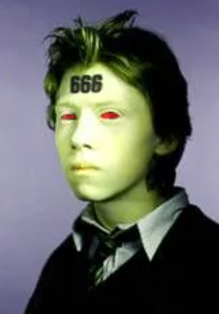
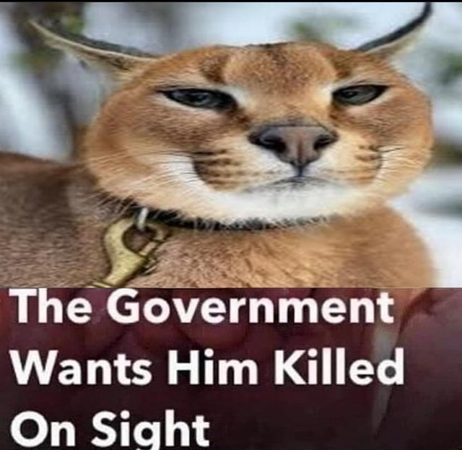
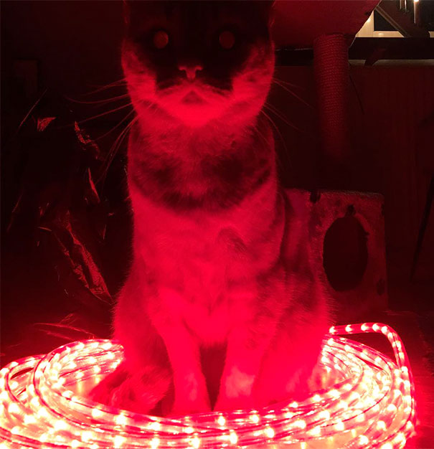
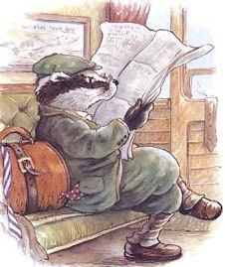
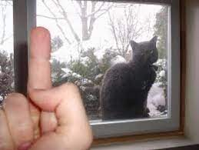
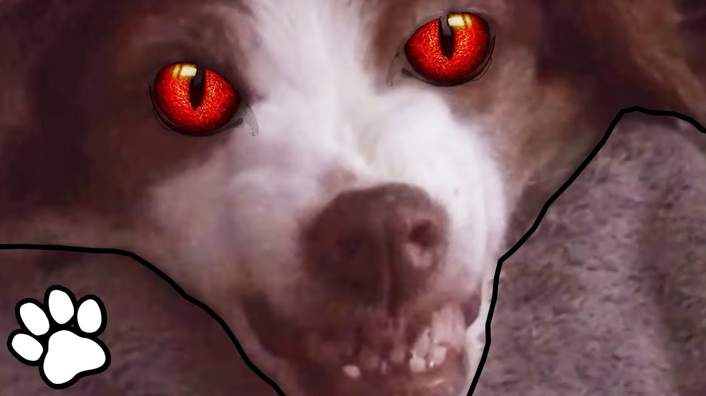
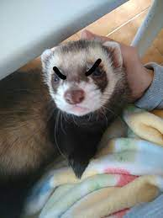
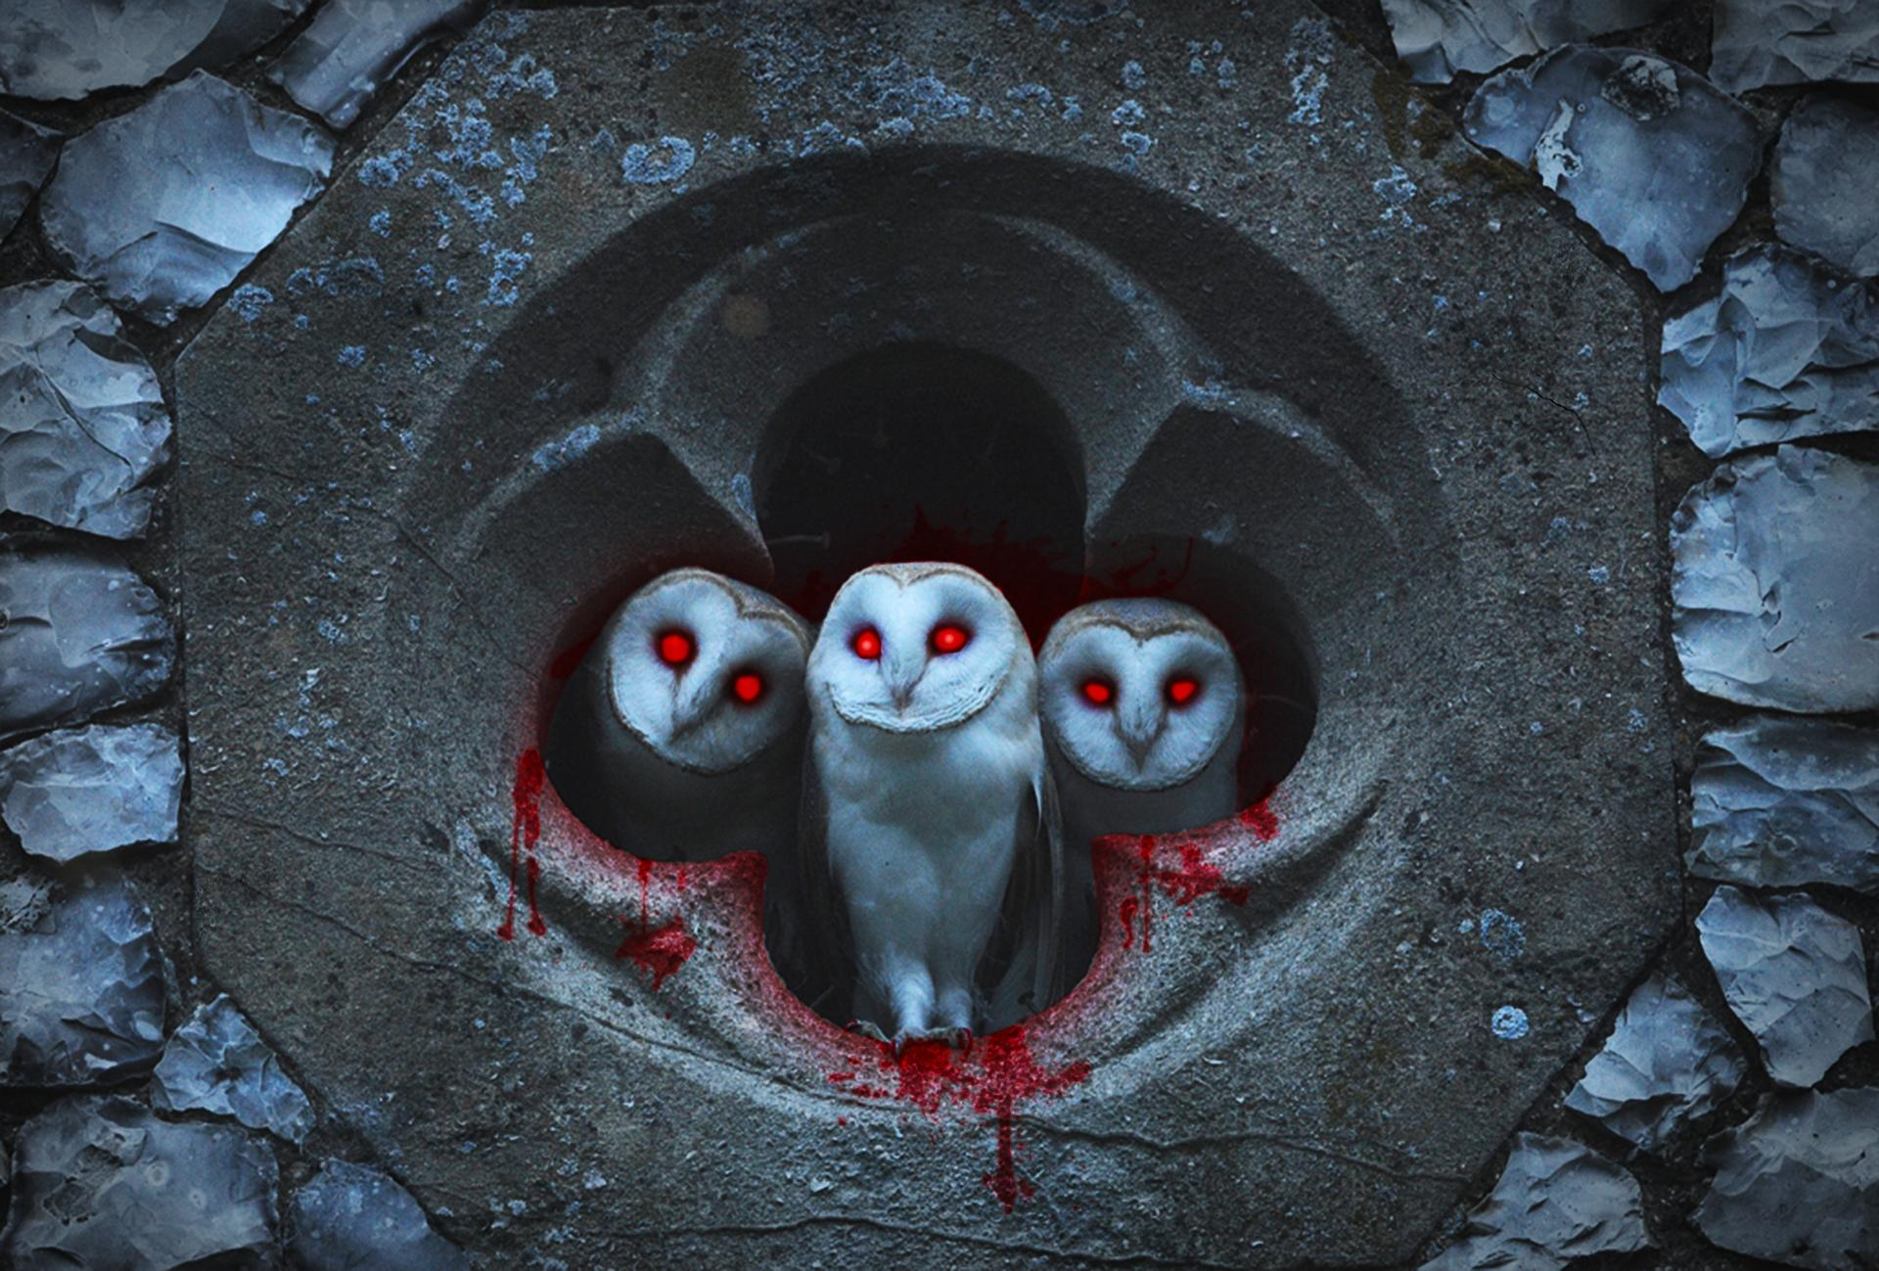
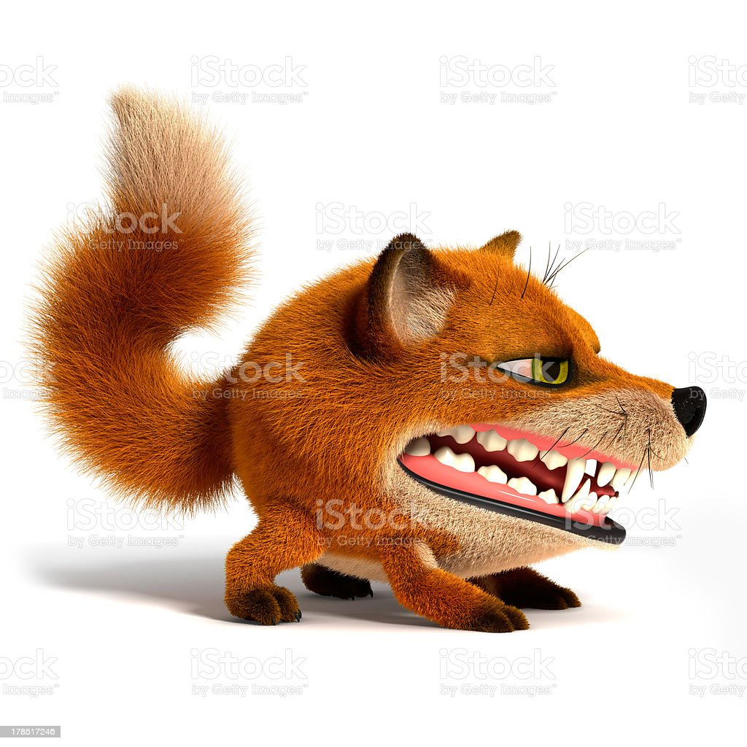
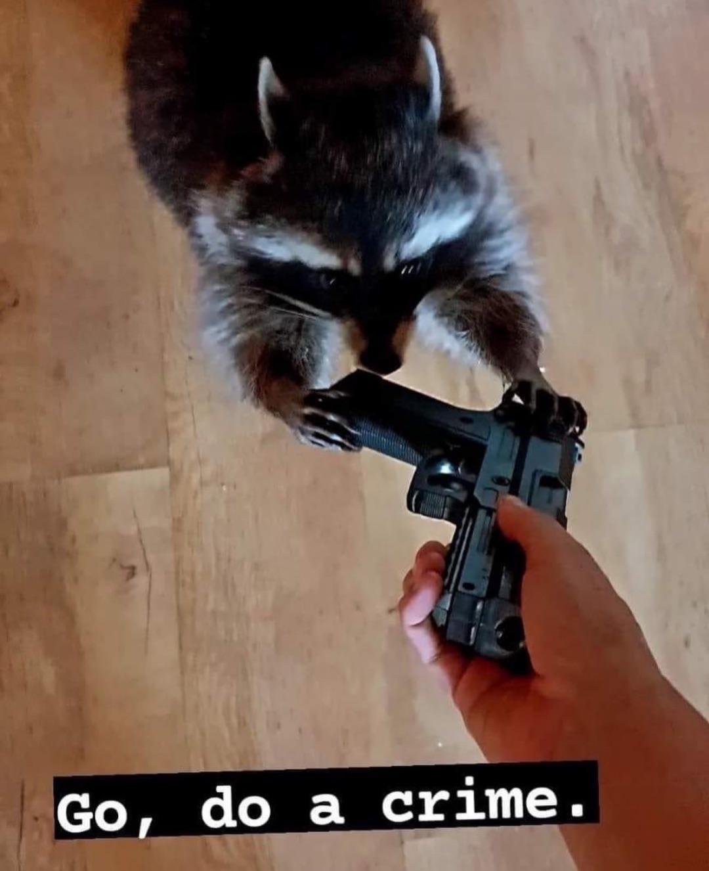
ENEMIES
I don’t care how cute they are fuck these bitches they’ll eat my precious bun buns
cats
dogs
farris ferrets
big boi owls?
foxes
raccoons
large snakes
badgers
weasles

Slide 9
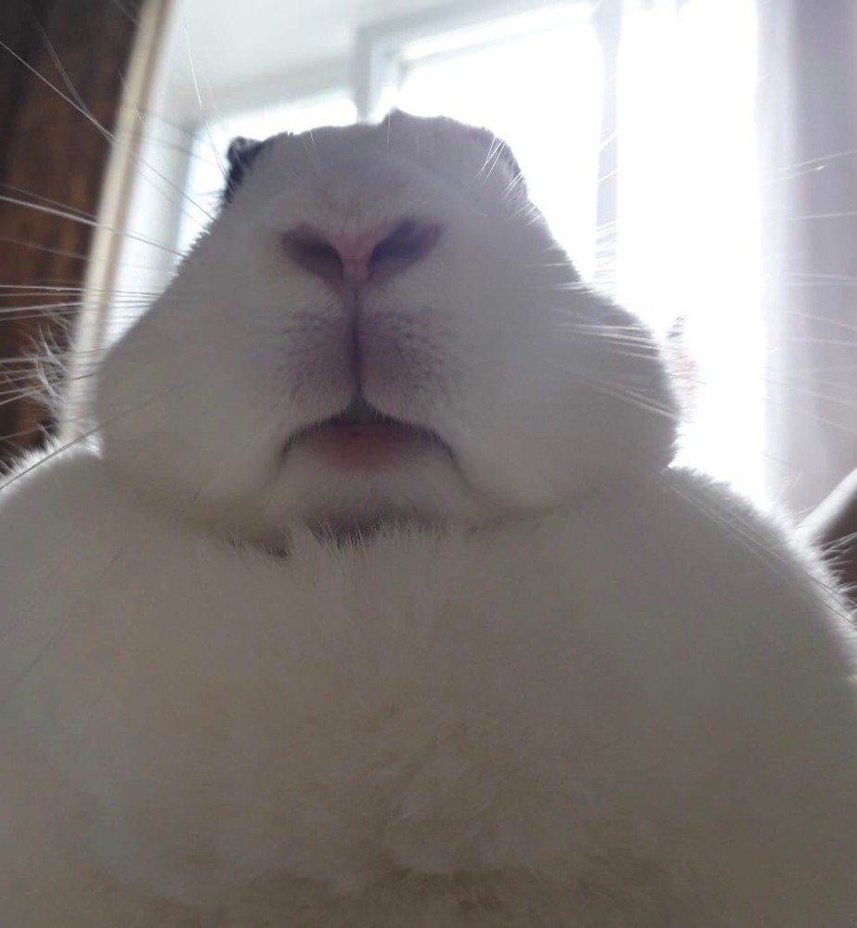
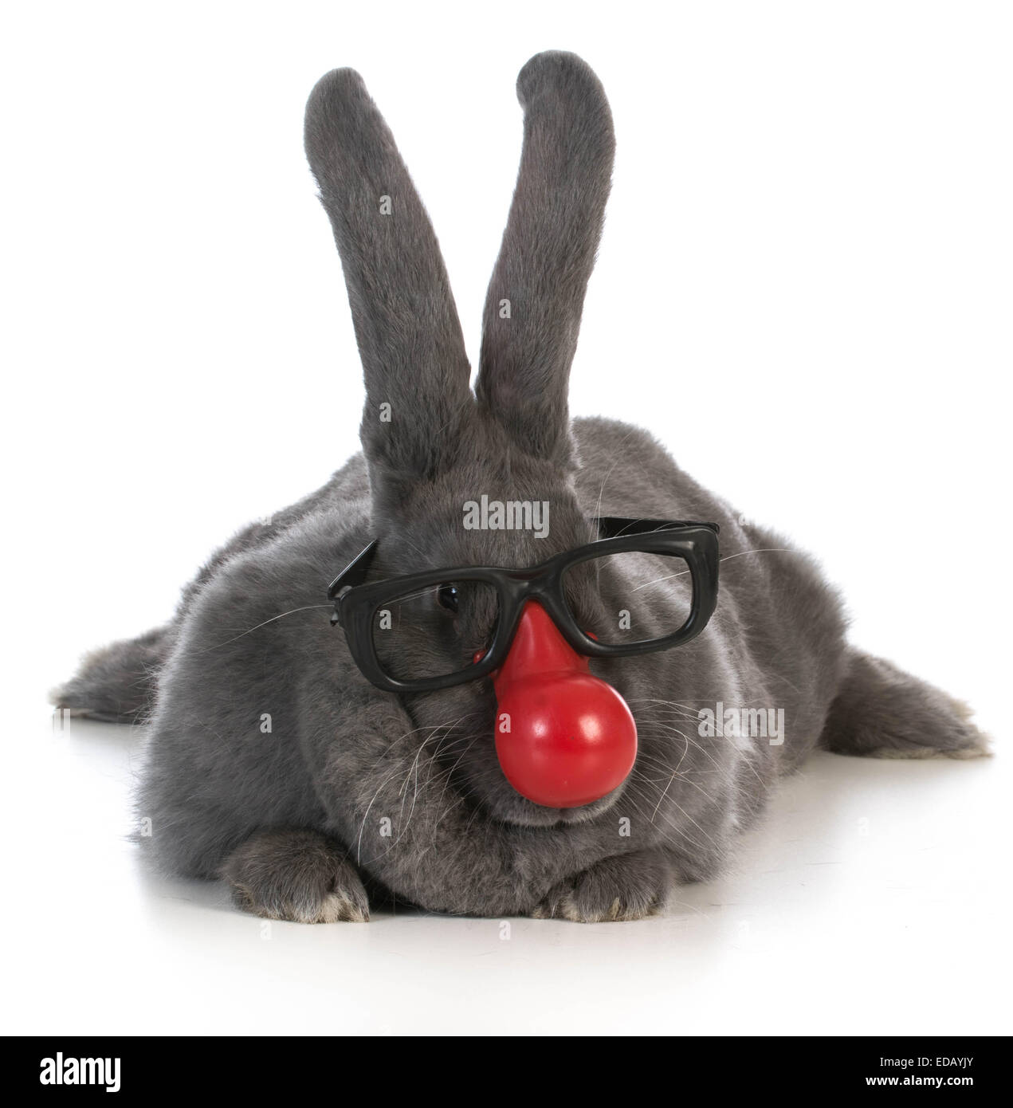
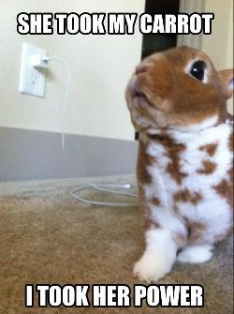
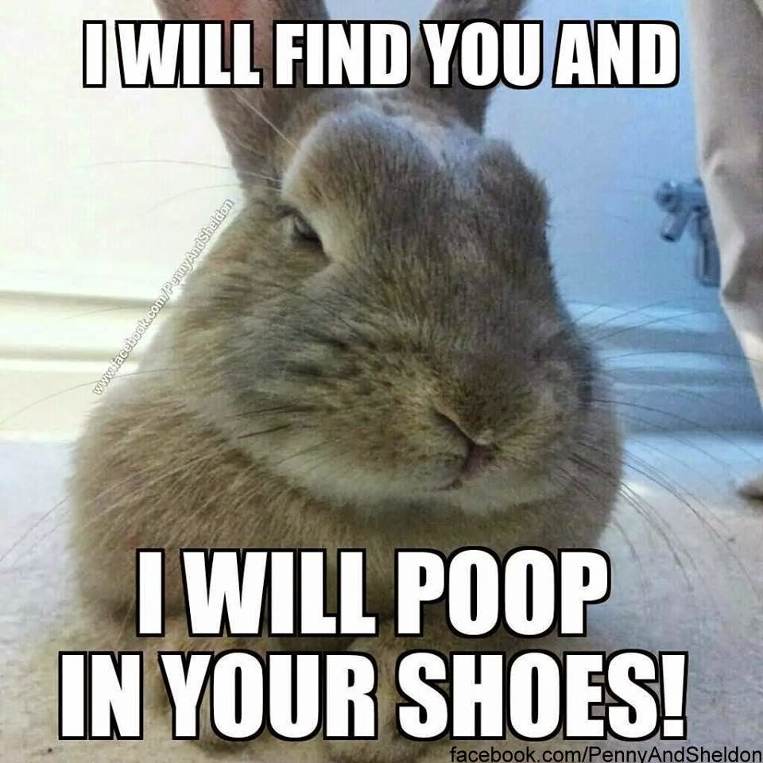
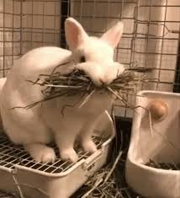
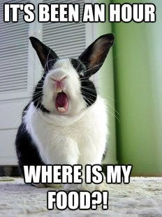
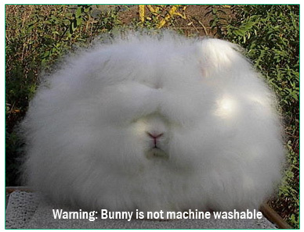
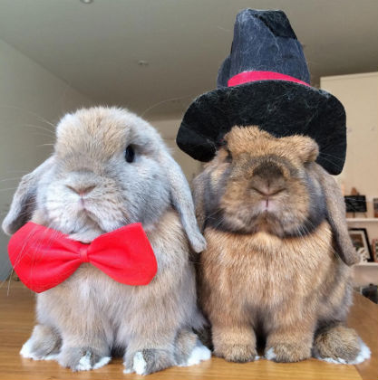
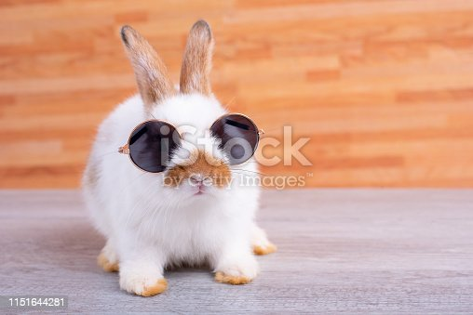
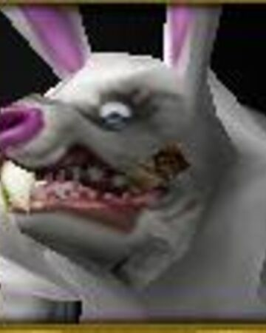
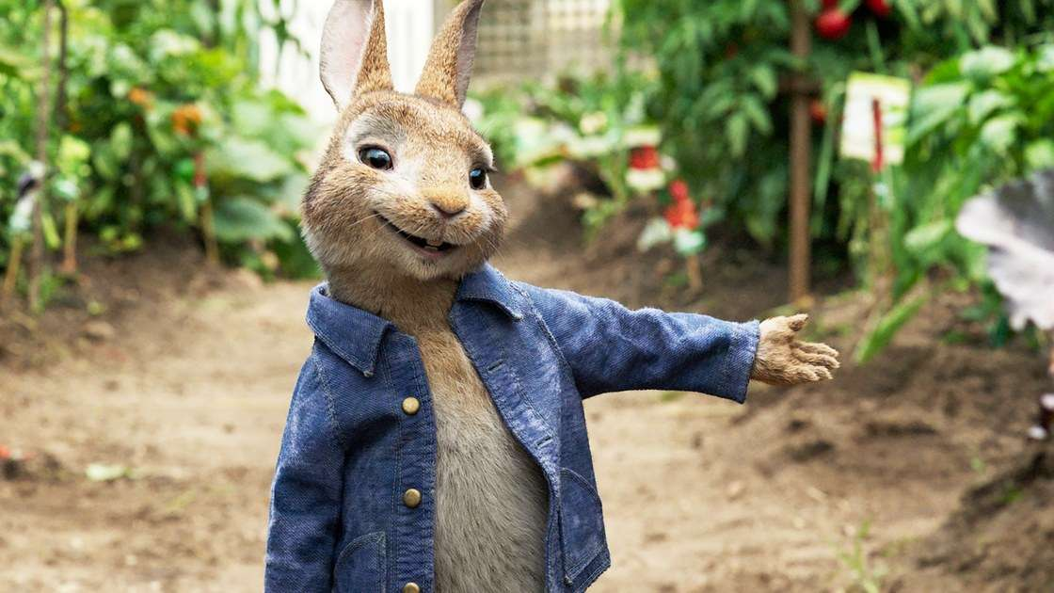
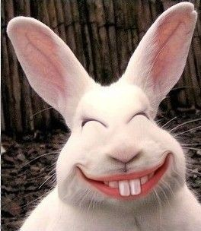


That’s it
DISCLAIMER: I’ve not looked up most bunny facts this is just what I know from the top of my head and my sister is the
Real bunny expert so Amber if you see any mistakes, please don’t kill me
bye

